Slide 1

Company: CCT
Test request number: 02.264.881
System name & temperature range: A (-00- 00)
Profile name: ISTA TD i4U_Sumner_U8 hePeaf
Author: k. Del+ano
STOP DATE:

Slide 2
Sample | Load | Duration | Max_Temp_48hrs | Min_Temp_48hrs | TC_No
1A | Min | 63.8 | 6.5 | 3.4 | TC 01 1
1A | Min | 64.1 | 6.5 | 3.3 | TC 01 2
1B | Min | 67.0 | 6.5 | 3.4 | TC 01 3
1B | Min | 66.9 | 6.5 | 3.4 | TC 01 4
2C | Max | 48.6 | 8.0 | 3.5 | TC 0221
2C | Max | 56.3 | 7.4 | 3.2 | TC 0222
2C | Max | 58.1 | 7.1 | 3.2 | TC 0223
2C | Max | 56.5 | 7.3 | 3.2 | TC 0224
 |  | 0.0 | 35.3 | 20.6 | TC 0111
 |  | 0.0 | 35.2 | 20.6 | TC 0112
1C | Min | 58.1 | 7.1 | 3.3 | TC 01 5
1C | Min | 58.2 | 7.1 | 3.2 | TC 01 6
2A | Max | 55.8 | 7.8 | 3.3 | TC 0213
2A | Max | 60.6 | 7.2 | 3.2 | TC 0214
2A | Max | 63.4 | 6.8 | 3.1 | TC 0215
2A | Max | 62.7 | 6.8 | 3.2 | TC 0216
2B | Max | 62.2 | 7.0 | 3.3 | TC 0217
2B | Max | 57.6 | 7.5 | 3.4 | TC 0218
2B | Max | 64.0 | 6.7 | 3.0 | TC 0219
2B | Max | 60.5 | 7.2 | 3.2 | TC 0220

Slide 3
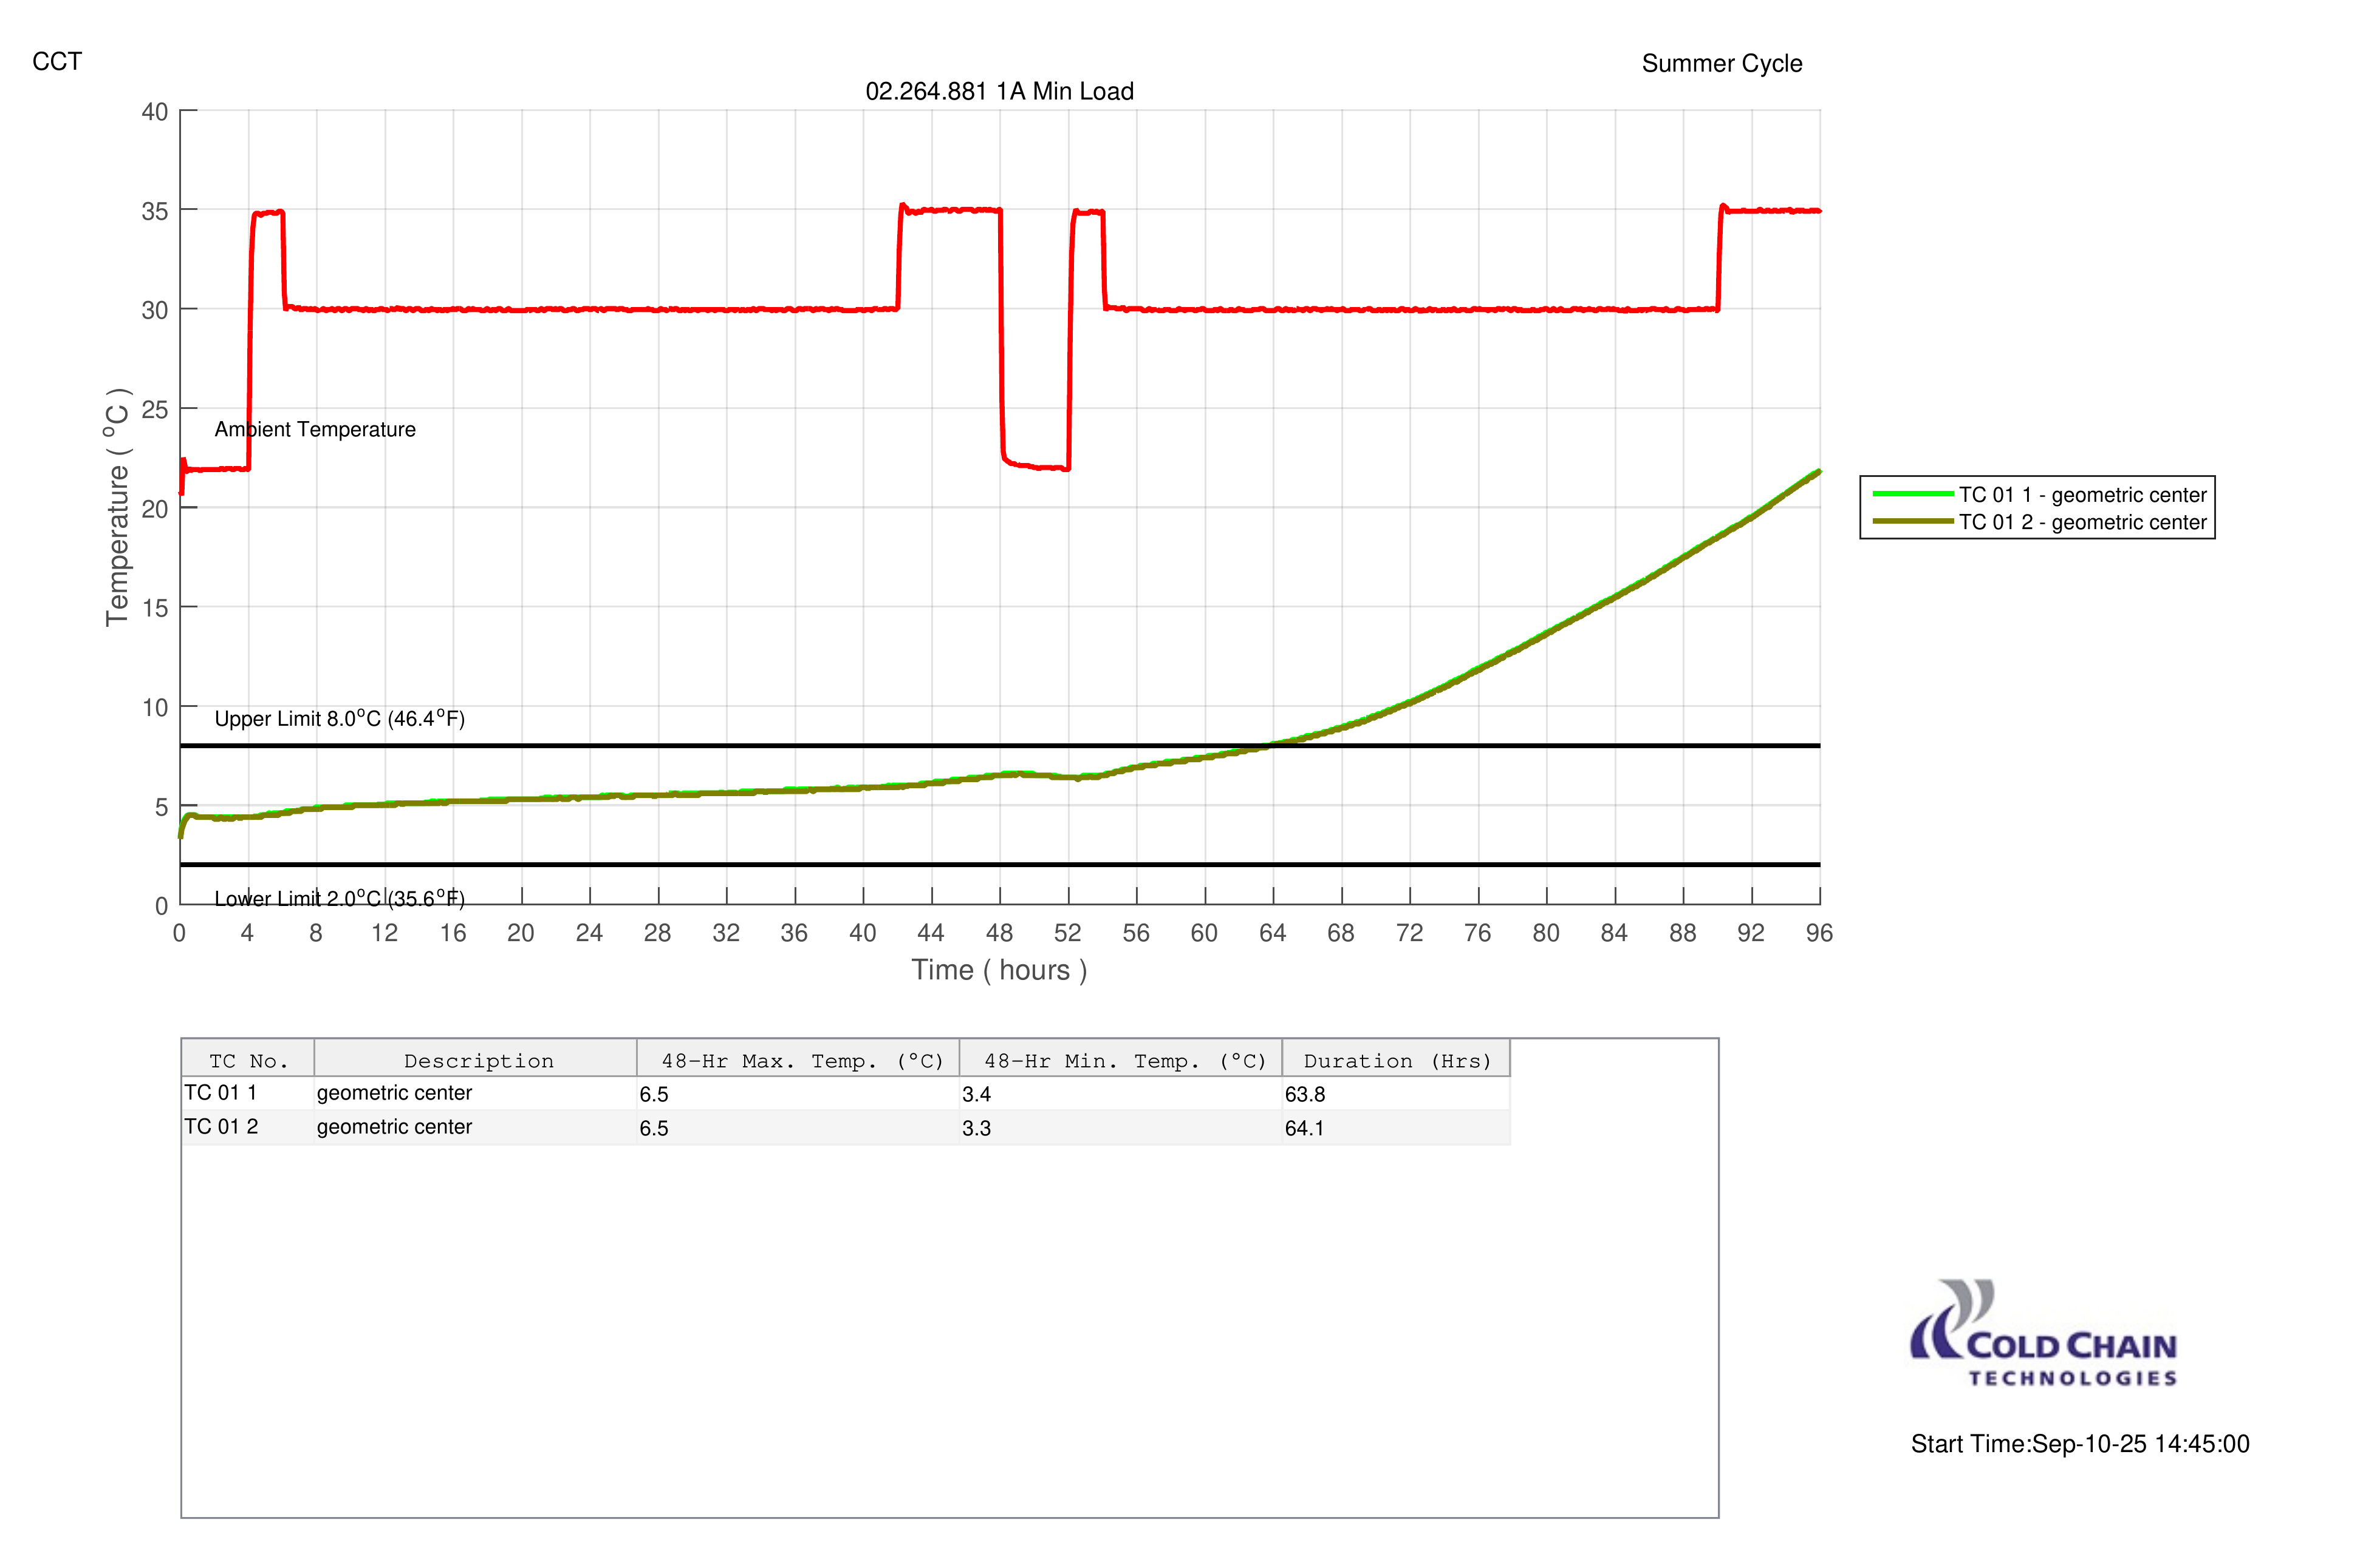

Slide 4
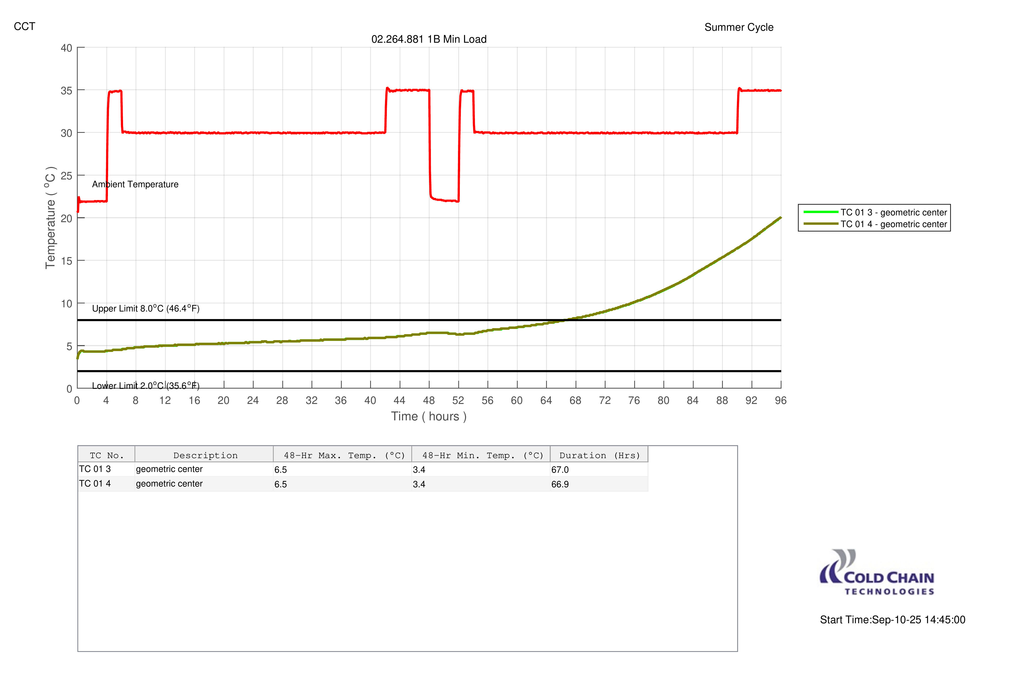

Slide 5
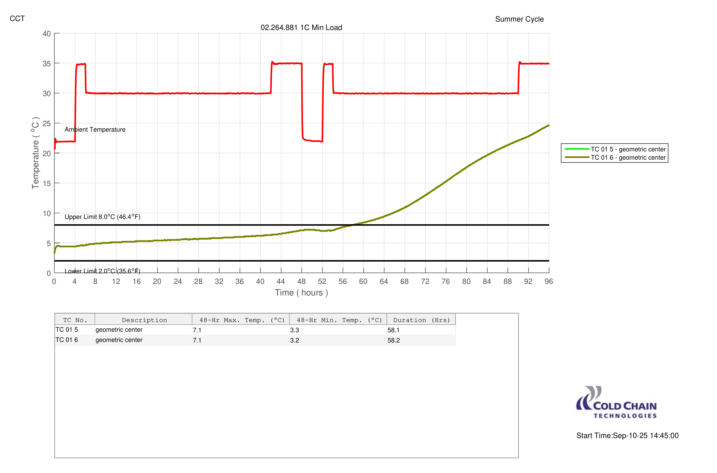

Slide 6

Sample Document
This is a sample DOC file text, an image, and a table.
ID | Name | Status
1vri4r | Sample A | PASS
2 | Sample B | FAIL

Slide 7
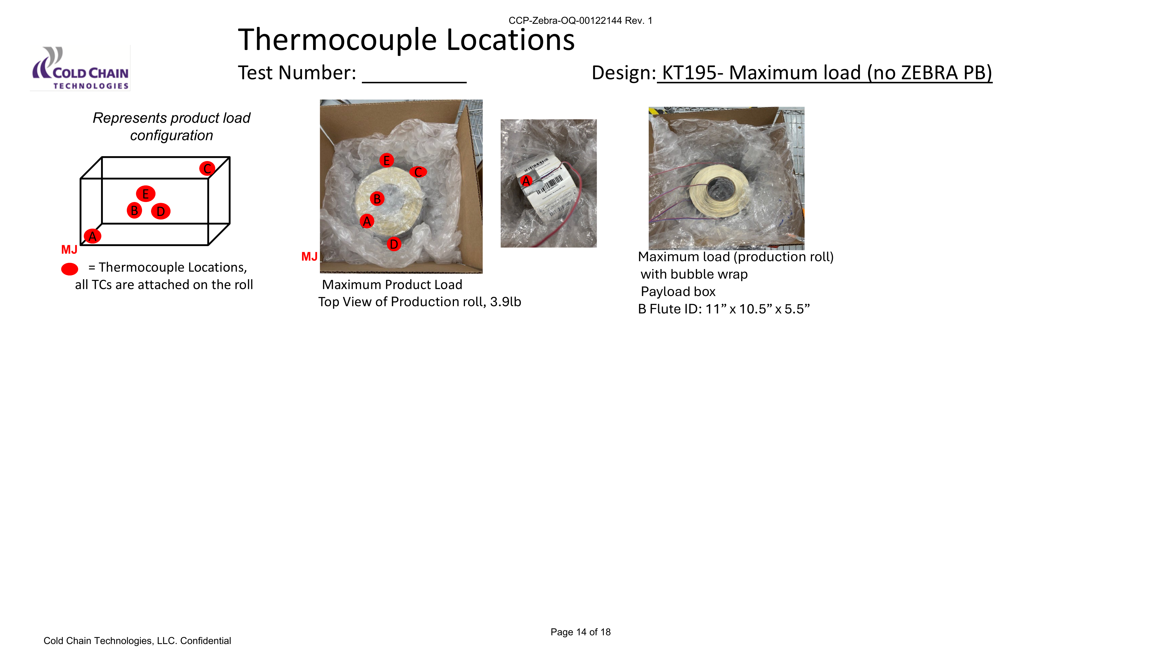
 |  | Product Load
Location | Description / Sample ID | 2A | 2B | 2C
A | Bottom Left Corner
B | Geometric Center (inside of roll)
C | Top Back Right Corner
D | Front Face Center
E | Back Face Center
Chamber Ambient TCs
Responsible Technician Initials/Date
Notes:
[[822.0, 83.0], [1980.0, 91.0], [1979.0, 186.0], [821.0, 178.0]]
<number>

Slide 8


Slide 9


Slide 10
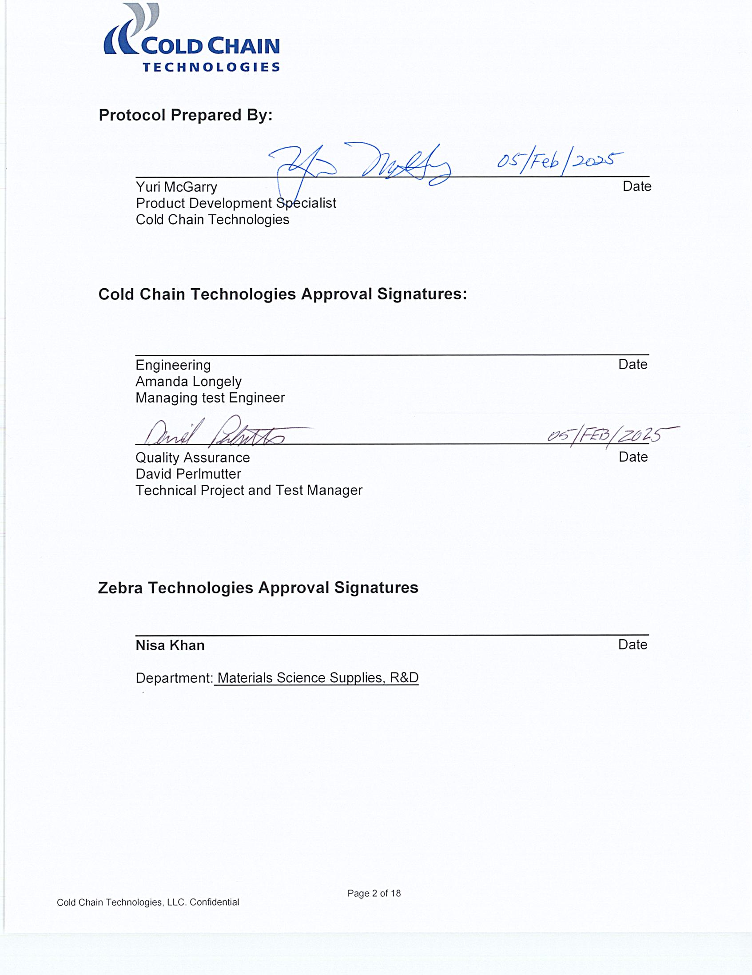

Slide 11


Slide 12
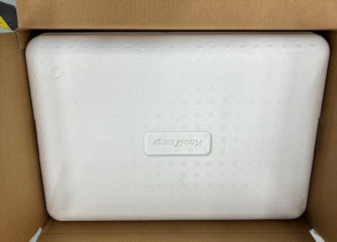

Slide 13
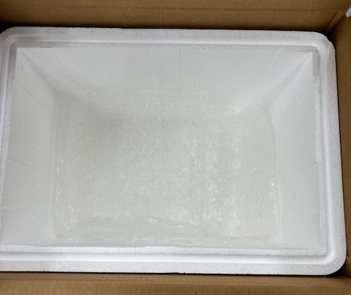

Slide 14
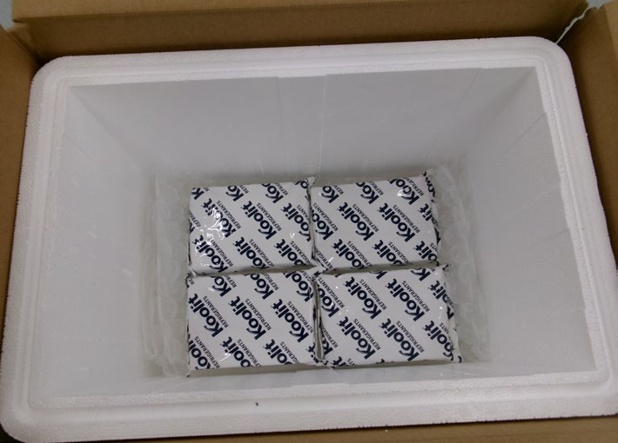

Slide 15
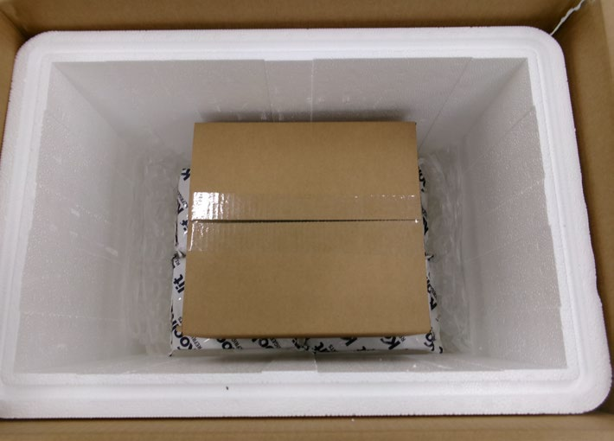

Slide 16
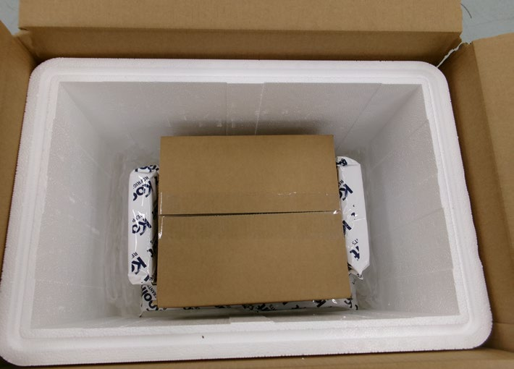

Slide 17
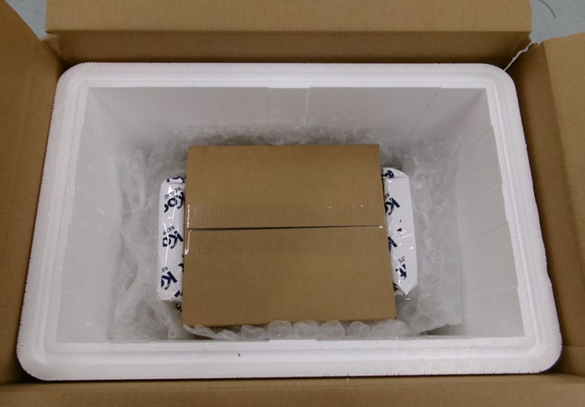

Slide 18
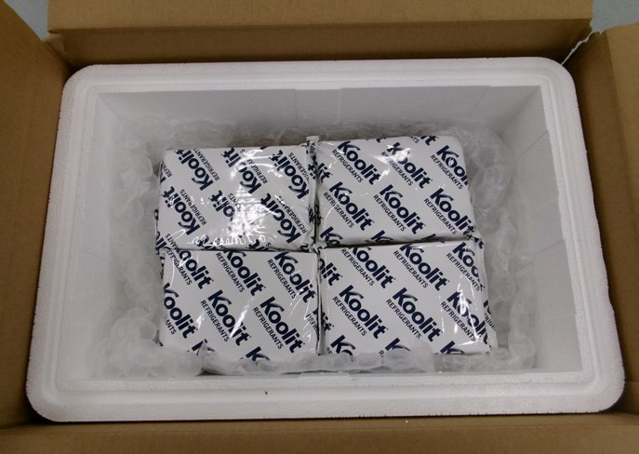

Slide 19
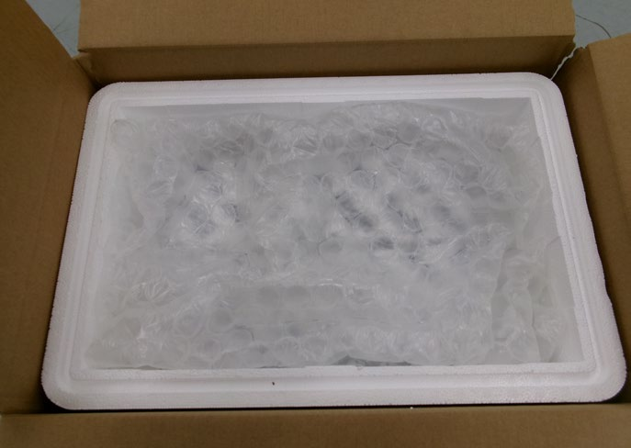

Slide 20
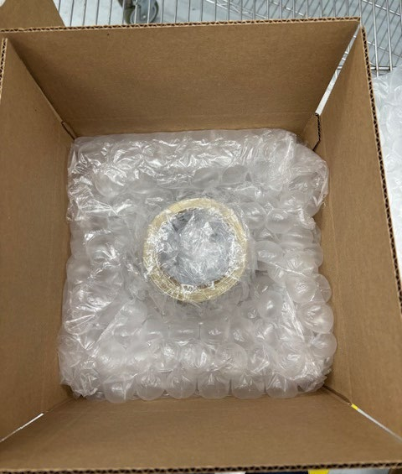

Slide 21


Slide 22


Slide 23
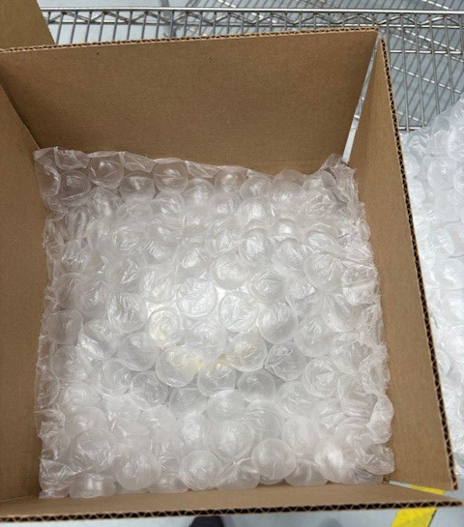

Slide 24
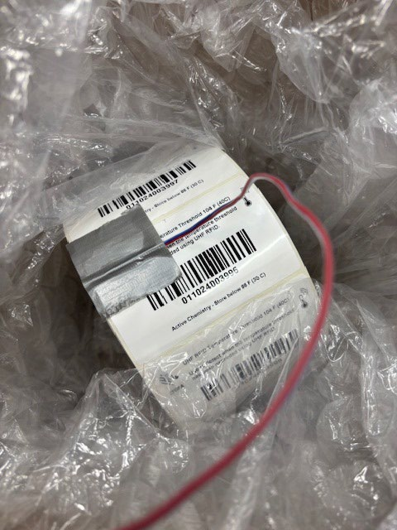

Slide 25
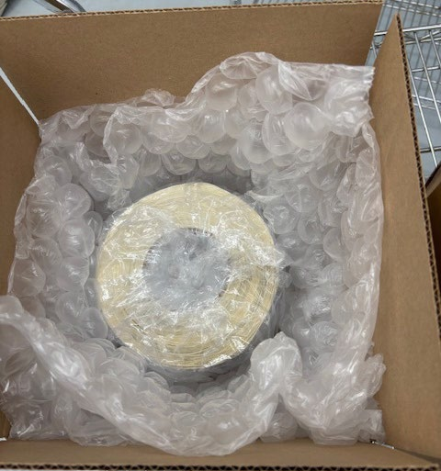

Slide 26
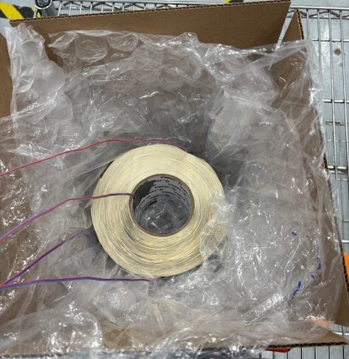

Slide 27


Slide 28
